Slide 1
Continental Drift Theory
Week 1 Lesson 2

Slide 2
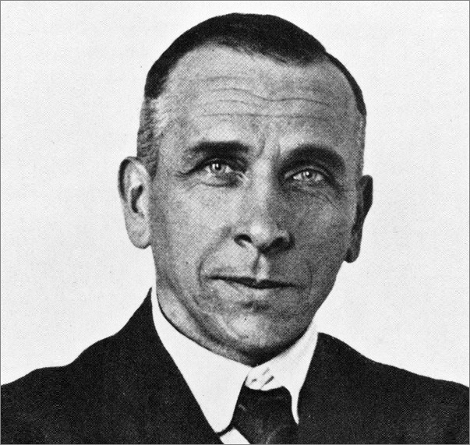
Alfred Wegener
In 1912, a German scientist called Alfred Wegener challenged the belief that the Earth's crust was static and unchanging.
He believed the continents of the world has previously been all joined in a “supercontinent” called PANGEA
Wegener introduced the “Continental Drift Theory”

Slide 3
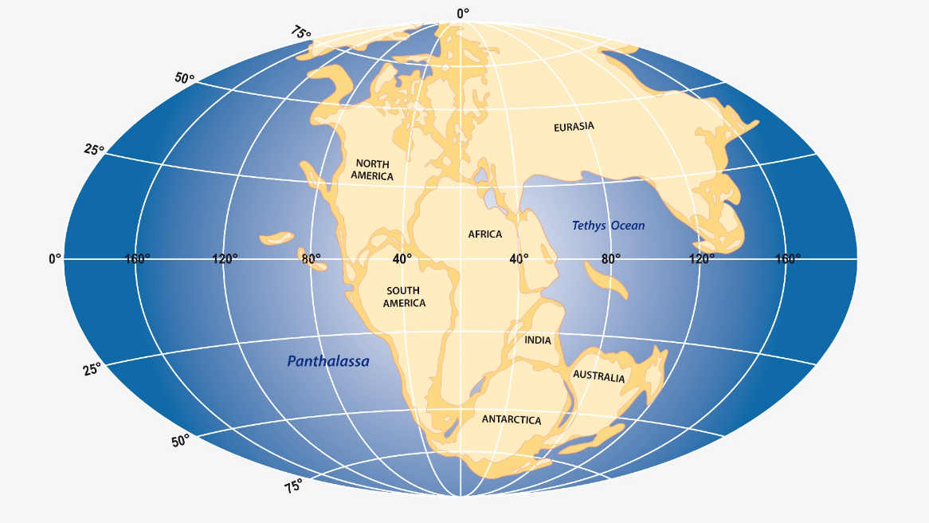
Pangea
280 million years ago the continents formed a single large landmass. This supercontinent is known as Pangaea.
Slow changes on the Earth's surface don't just move entire continents, they create huge mountain range!

Slide 4
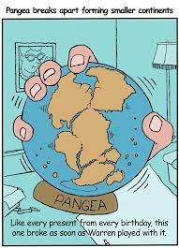
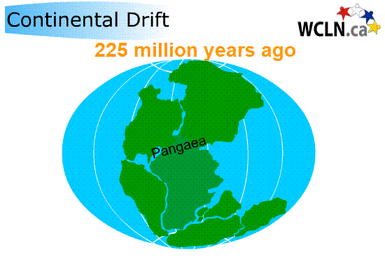
Continental Drift Theory
Pangaea broke up into several smaller continents. Over millions of years, the continents slowly drifted into their present day positions – and they're still on the move.

Slide 5
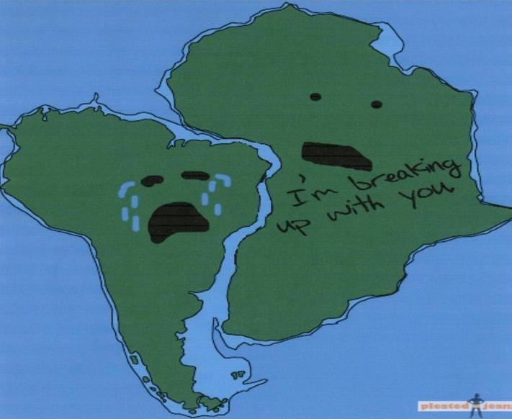
Wegener’s Evidence
Continental Jigsaw
Fossils matching across seas
Rock type and structure
Ancient Climate

Slide 6
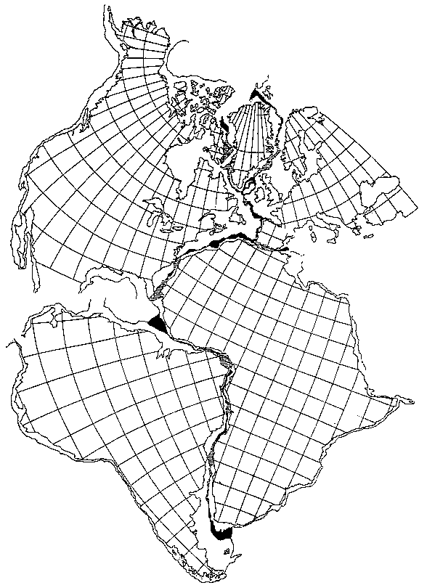
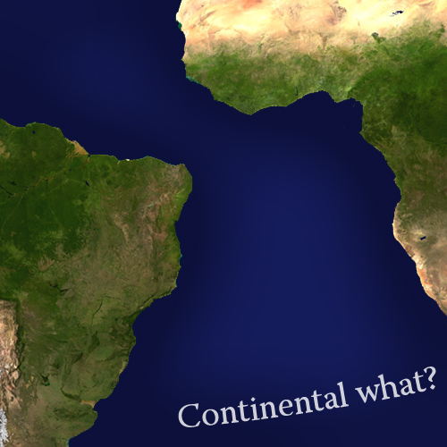
1. Continental Jigsaw
The continents fit together like puzzle pieces
Example:
The east coast of South America and west coast of Africa match

Slide 7
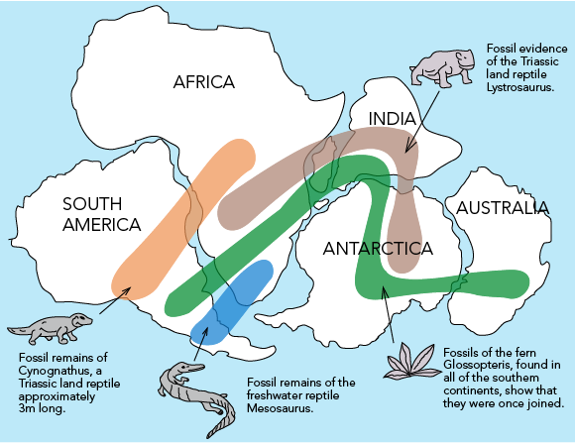
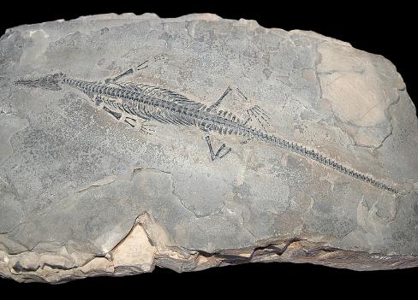
2. Fossil Clues
Identical animal and plant fossils were found on separate continents.
Animal Example: Mesosaurus
An extinct reptile fossil was found on South America and Africa
Plant Example: Glossopteris
Same plant found on Africa, India, South America, and Antarctica.

Slide 9
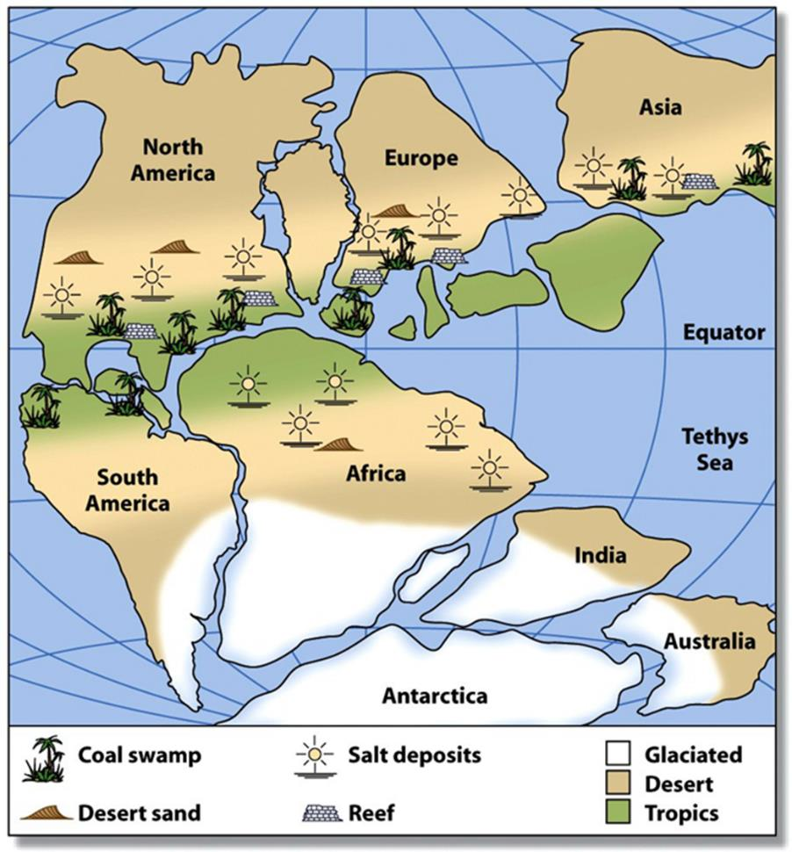
3. Climate Clues
Wegener noticed evidence of major climate changes
Example 1: Tropical plants in Arctic areas
Warm weather plant fossils were found in the Arctic.
Example 2: Glacier scratches found on land in tropical areas
Glacier evidence is found in areas where there are no glaciers.

Slide 10
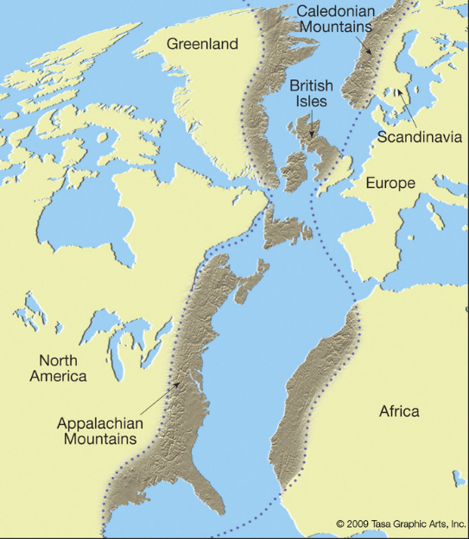
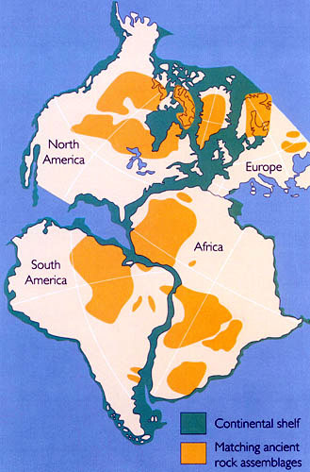
4. Rock Clues
Rock and rock structures on different continents are the same where the land was once joined.
Rock Example: North America and Europe
Appalachian Mountains in Eastern US once joined Europe
Rock Example: Coal Fields
Coal fields in North America and Europe match up.

Slide 11
Accurate?
https://www.youtube.com/watch?v=zocutif0cQY

